Slide 1
Presentation & Demo
August 7, 2018
Bill Shelden

Slide 2
Topics
Introduction
Architecture
PerfTechPro zAnalytics® for z/OS features facilitate:
  Performance and Capacity Reporting
  Performance Problem Resolution
  LPAR Configuration Analysis
  Workload Analysis
  Job Analysis
  DASD IO Subsystem Analysis
  Processor Cache Analysis (SMF 113s)
  Performance/Capacity Planning – Correlation Analysis
  Capacity Planning – Forecasting Tool
  Capacity Planning - CPU Sizing Tool
  Capacity Planning - CPU Modeling Tool

Slide 3
Introduction
PerfTechPro is a cost effective software product that:
  Gathers RMF and SMF data from z/OS systems
  Stores that data in a relational database on a Windows server
  Provides access to the data, tools and analysis through a local client or multiple remote clients on the network
  Contains a complete scripting language so the user can automate all PerfTechPro functionality
  Built on a Windows service architecture
Notes:
Thank you for your interest in PerfTechPro. PerfTechPro is:
A cost effective software product
That Gathers RMF and SMF data from IBM mainframes
Stores that data in a relational database on a Windows server
Provides access to the data through a local client or multiple remote clients
Provides a number of Performance Management and Capacity Planning functions as defined in the bulleted list on this slide
In subsequent slides in this presentation, we will explore each of the functions in the bulleted list.

Slide 4
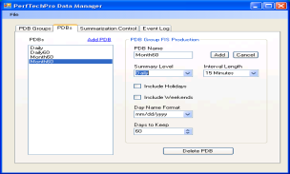
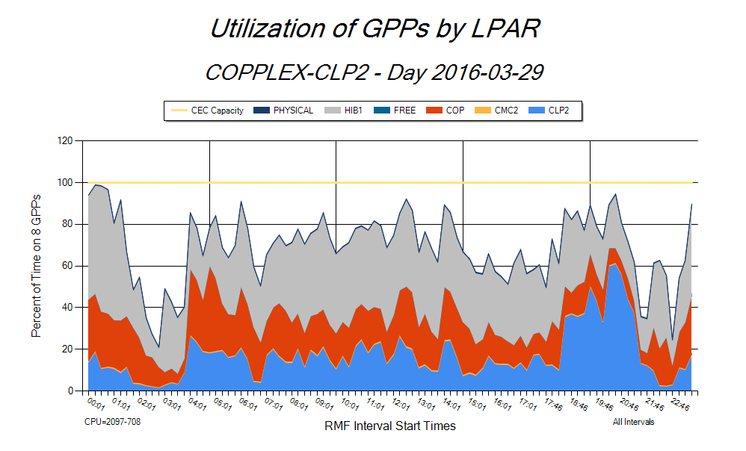
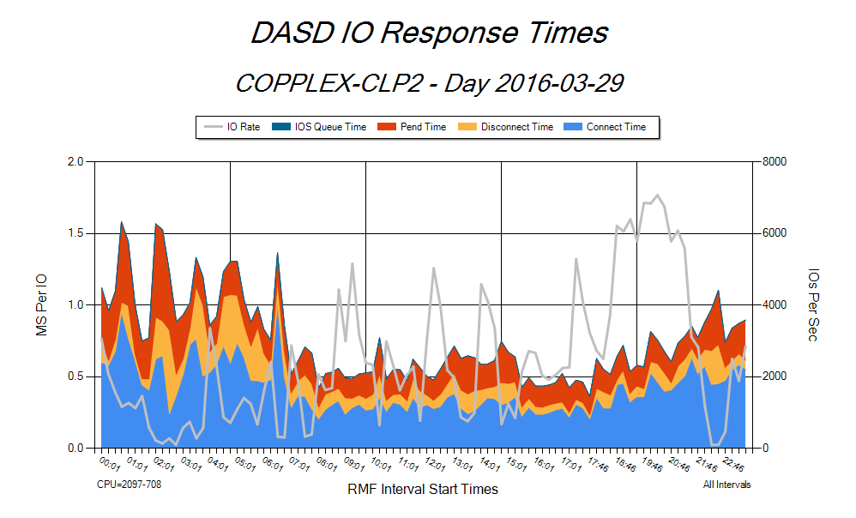
Architecture
Data Manager
PerfTechPro
Service
z/OS FTP
PerfLogs
Local
Visualizer Client
z/OS Assembler Programs
PerfTechPro
Database
Daily PDB
Remote
Visualizer Client
Summary PDBs
Windows Server
Notes:
Here is a schematic of the architecture of PerfTechPro
.
It shows how RMF and SMF data from any or all z/OS LPARs running in the enterprise is processed, typically once per day, by PerfTechPro assembler programs running on a z/OS system.
Perflogs, which are just CSV files, created by this process are transferred to the Windows server where the PerfTechPro service is installed
There perflogs are processed by the service and stored in relational databases
Definition and management of the PerfTechPro databases is done through the Data Manager component of PerfTechPro
The Visualizer Client component of PerfTechPro provides the user local and remote access to the data stored in the PerfTechPro databases

Slide 5
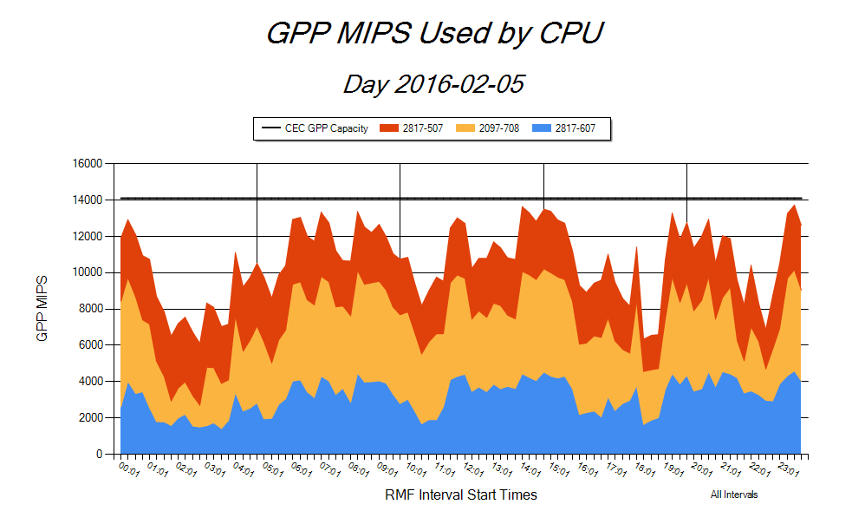
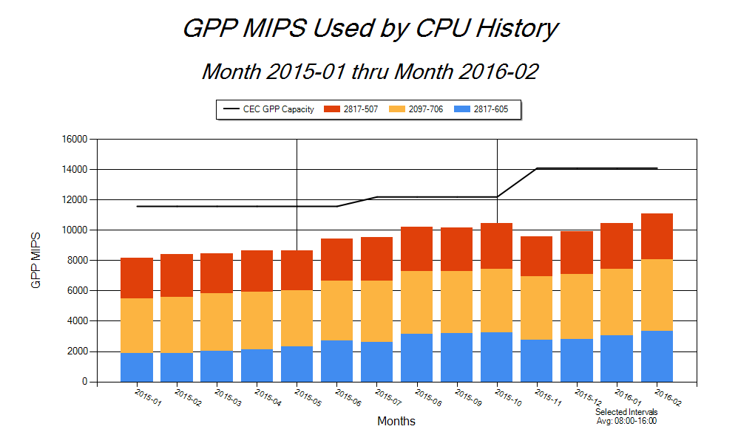
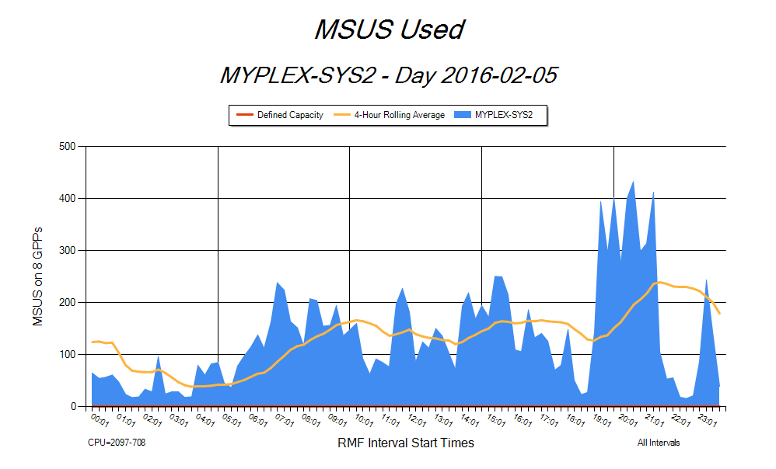
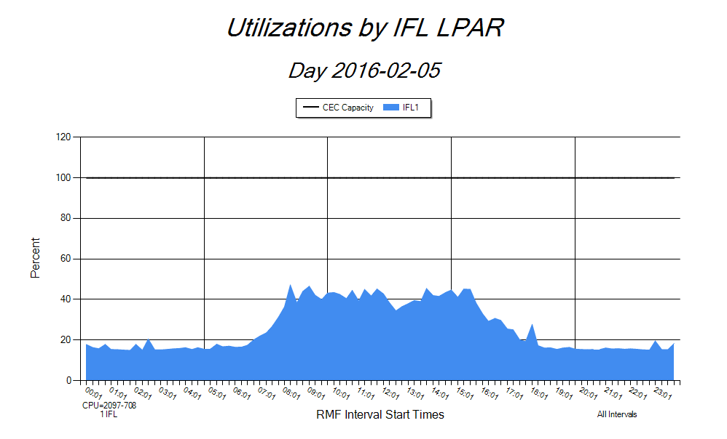
Enterprise GPP MIPS usage on 3 CPUs on 2/5/2016
Performance and Capacity Reporting
Enterprise GPP MIPS usage across 14 months with 2 CPU upgrades
MSU usage of SYS2 with 4Hr Rolling Avg on 2/5/2016
IFL MIPS usage on 2097-708 on 2/5/2016
Notes:
One of the first things a new PerfTechPro user will do is regular performance and capacity reporting. This slide contains four typical charts that might be included in a user’s reporting. The charts show:
(Upper left) MIPS usage by CPU in the Enterprise for a particular day
(Upper right) MIPS usage by CPU over the last 14 months for the prime shift
(Bottom left) MSUS and the rolling 4-hour average on the SYS2 LPAR for a particular day
(Bottom right) Utilization of IFLs by LPAR on a particular day

Slide 6
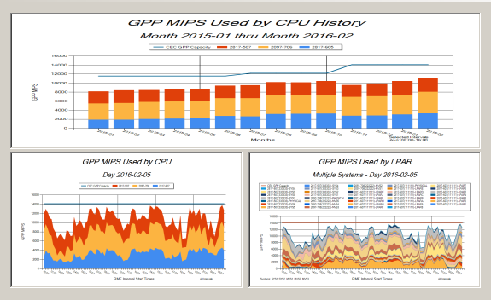
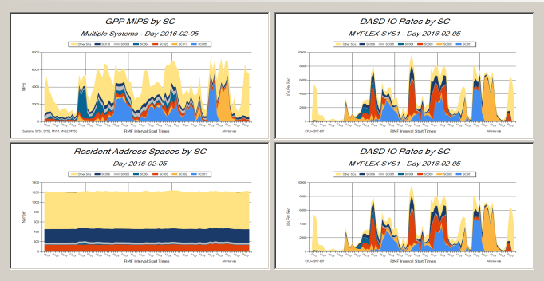
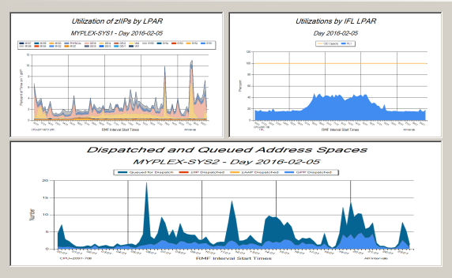
Reporting Flexibility
1 Up + 2 Up Window
4 Up
Window
2 Up + 1 Up Window
Notes:
A great deal of flexibility is provided in PerfTechPro that can be used to organize performance and capacity planning reporting information for presentation. PerfTechPro actually provides five of the sort of dialogs shown on this slide. Here we illustrate three of them.
2-Up Horizontal
2-Up Vertical
1-Up + 2-Up
2-Up + 1-Up
4-Up
The quadrants in any of these dialogs are populated by 1-click on a chart displayed in the Visualizer Client.

Slide 7
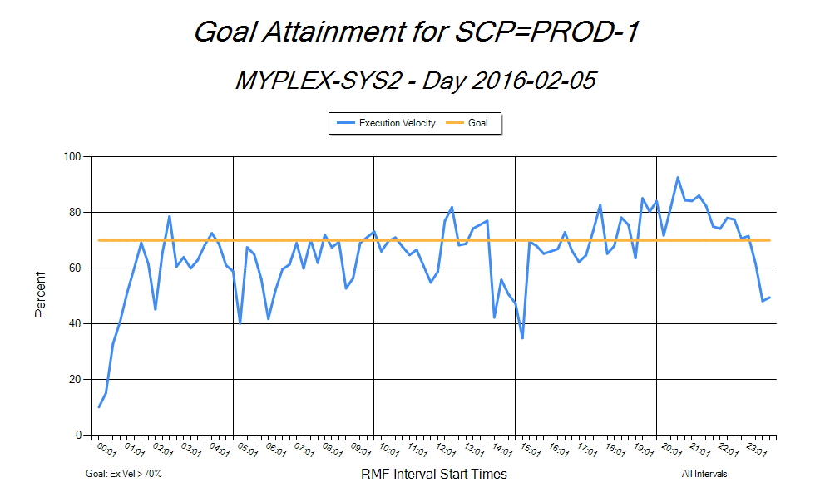
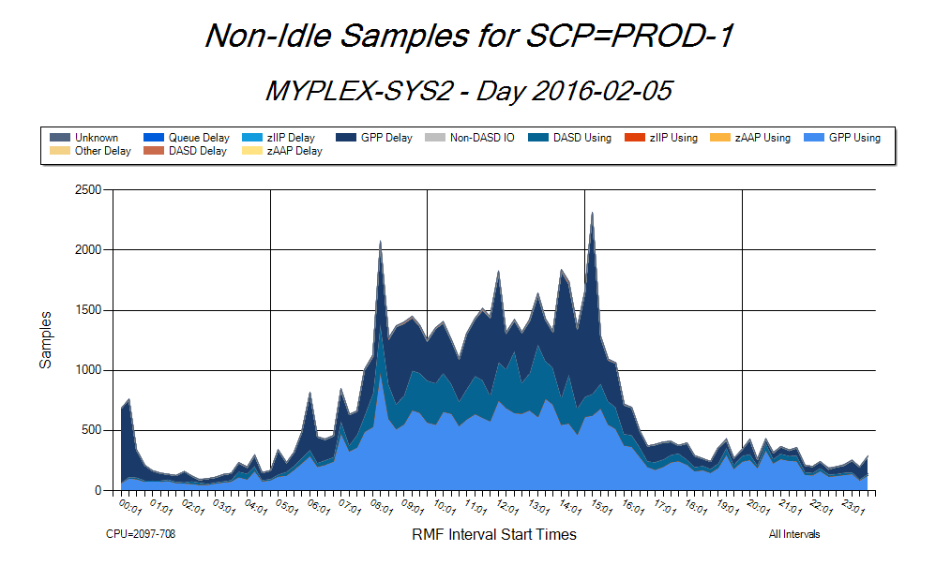
Performance Problem Resolution
PROD-1 is missing its goal in this part of the day
Problem is GPP Delay
Notes:
PerfTechPro is an ideal tool for performance problem resolution. Here we see in the left-hand chart that the first period of service class PROD is missing its goal in many intervals in a particular day. Its goal is an execution velocity of 70%. Since execution velocity is defined as using samples as a % of using plus delay samples, it is natural to consult the chart showing Non-Idle Samples for the service class period PROD-1. The right-hand chart shows these non-idle samples for PROD-1. We can see from this chart that the only delay samples for PROD-1 are GPP delay samples. This means that delay for the GPP resource is causing PROD-1 to miss its goal.

Slide 8
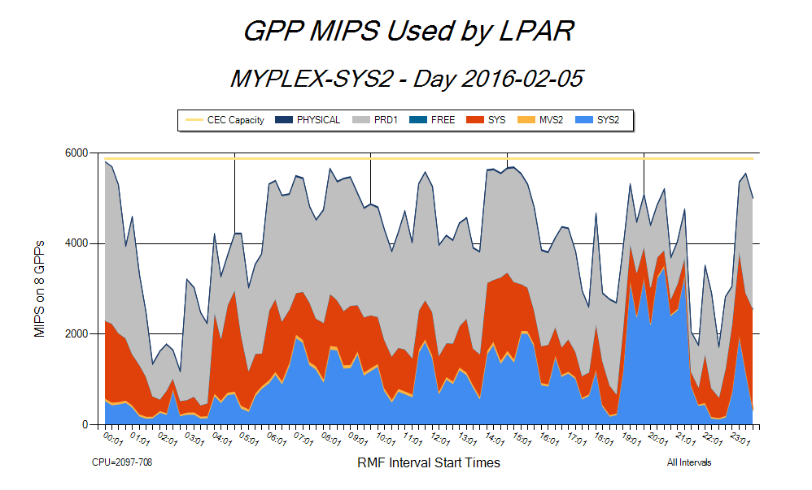
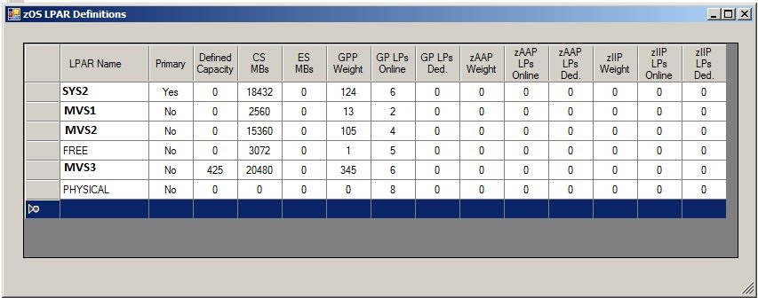
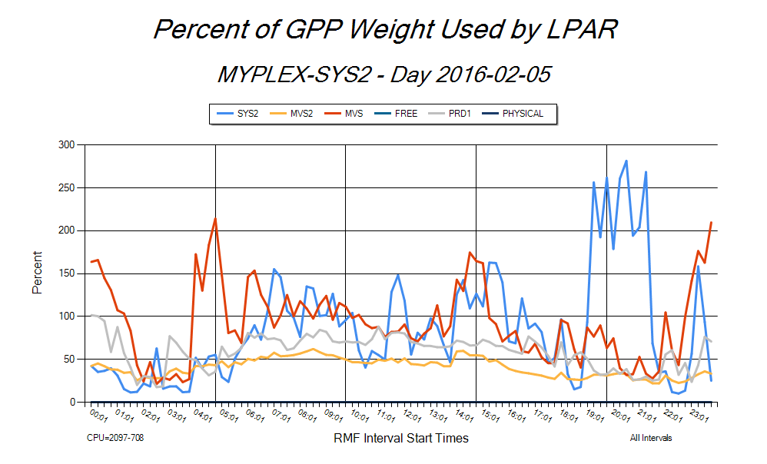
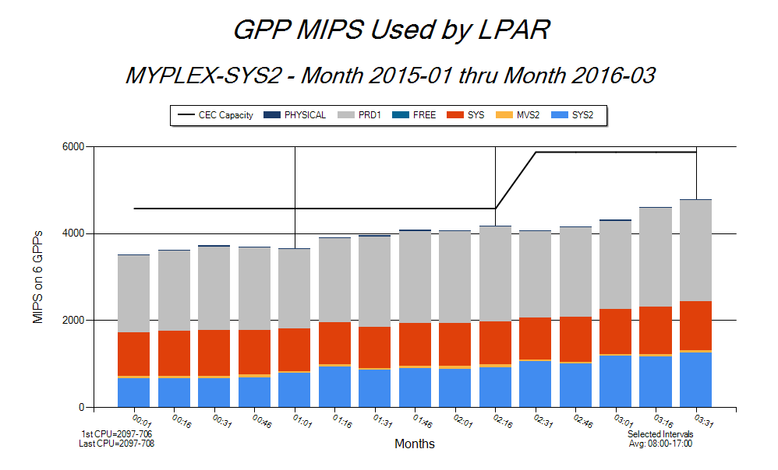
LPAR Configuration Analysis
LPAR MIPS usage over last 14 months. Note upgrade.
LPAR SYS2 is using over 200% of its weight
Notes:
Optimizing the LPAR configuration on a CPU is facilitated by PerfTechPro. Here we see three charts and a table that can be used to analyze the LPAR configuration in a particular CPU. The table shows various LPAR settings. Two of the charts (the top left and the bottom right) show MIPS usage by LPAR for a particular day and the last 14 months respectively. The bottom left chart shows how much of each LPAR’s weight is being used. This type of information can be used to tune each LPAR’s configuration settings as shown in the top right-hand table.

Slide 9
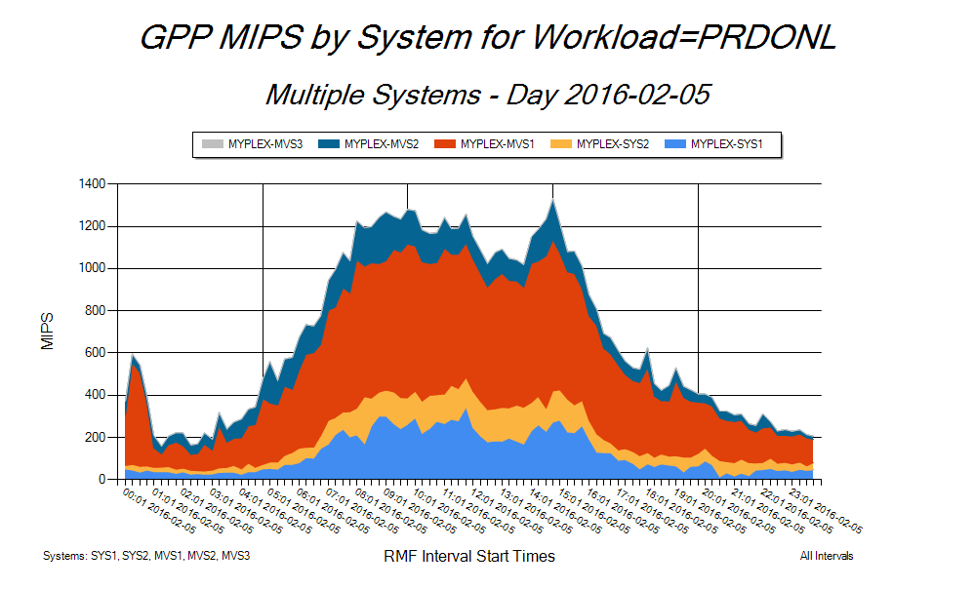
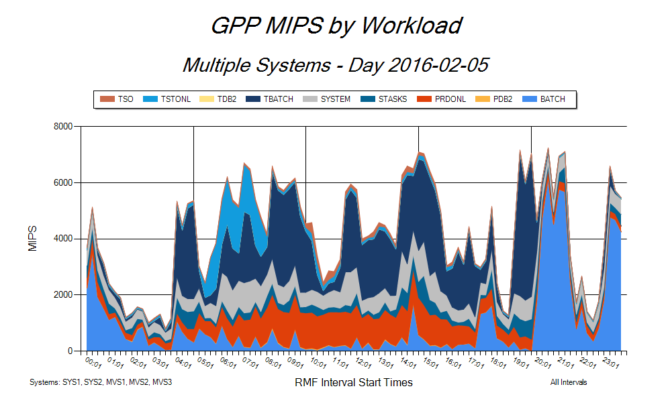
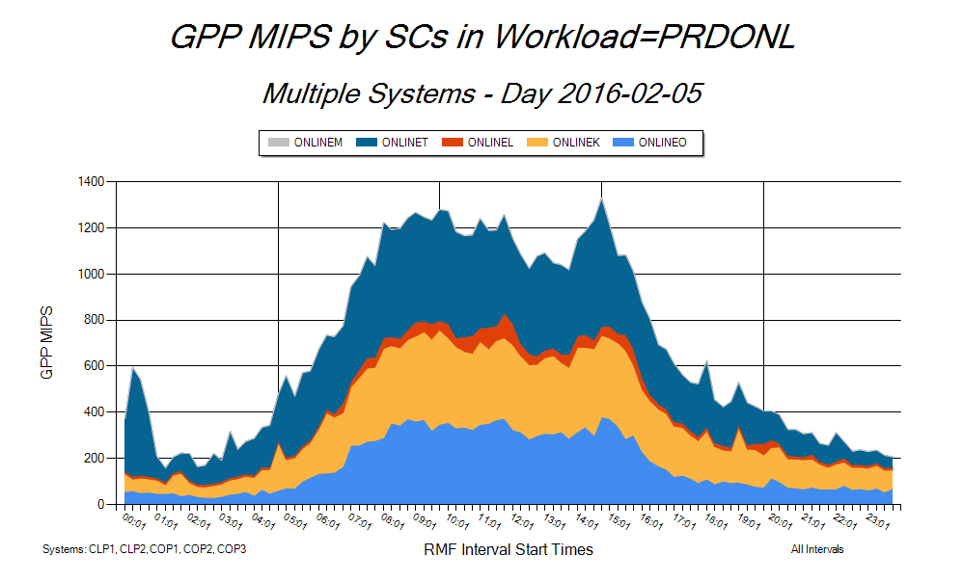
Workload Analysis
Look at MIPS usage by workload across 5 systems
Drill down to workload PRDONL MIPS usage on each system
Drill down to workload PRDONL MIPS usage for each of its SCs over 5 systems
Notes:
This slide illustrates the drill-down capability in the Visualizer Client component of PerfTechPro. There are five systems selected. The left-hand chart shows MIPS usage by workload on a particular day over all 5 systems.
When the user right-clicks on workload PRDONL on the left-hand chart, a drop-down menu appears from which the user selects the ‘Systems’ menu item. This produces the top right-hand chart showing how PRDONL’s MIPS usage is distributed across the 5 selected systems.
When the user right-clicks on workload PRDONL on the left-hand chart, the drop-down menu also contains a ‘Service Classes’ menu item. This produces the bottom right-hand chart showing how workload PRDONL’s MIPS usage is distributed across its service classes.

Slide 10
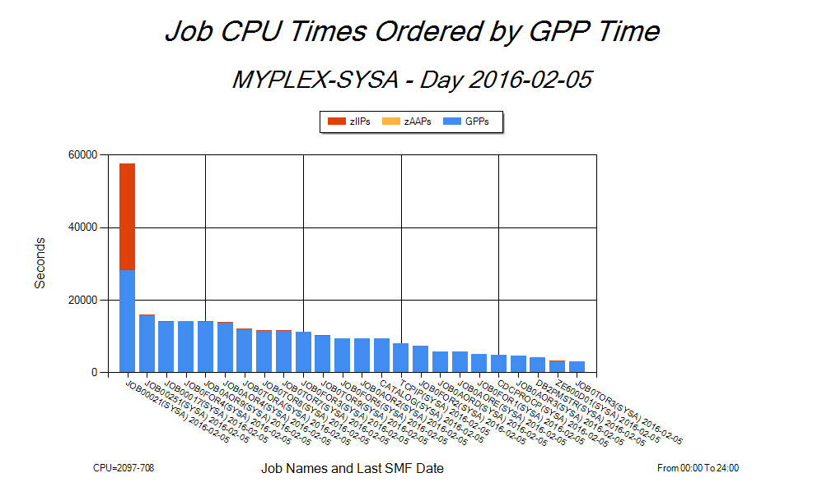
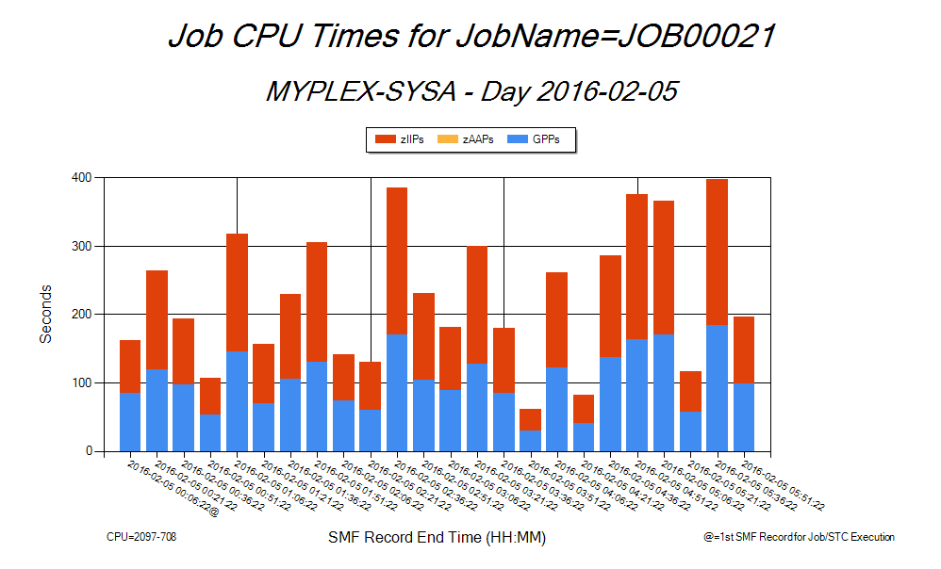
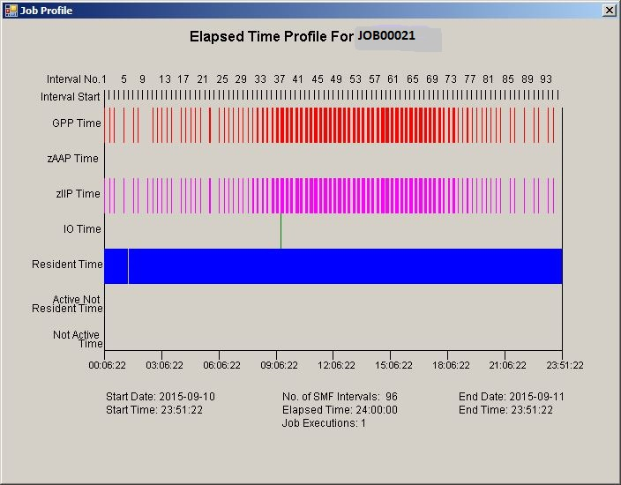
Job Analysis
Notes:
PerfTechPro allows the user to see detailed performance information at the individual Job level. This information is derived from the SMF Type 30 records. The top left-hand chart shows Jobs sorted by CPU time including GPP, zAAP and zIIP times. The top right-hand chart shows those same CPU times for a particular Job execution. The schematic in the bottom of the slide shows how CPU times and IO operations are distributed across the life of the Job.

Slide 11
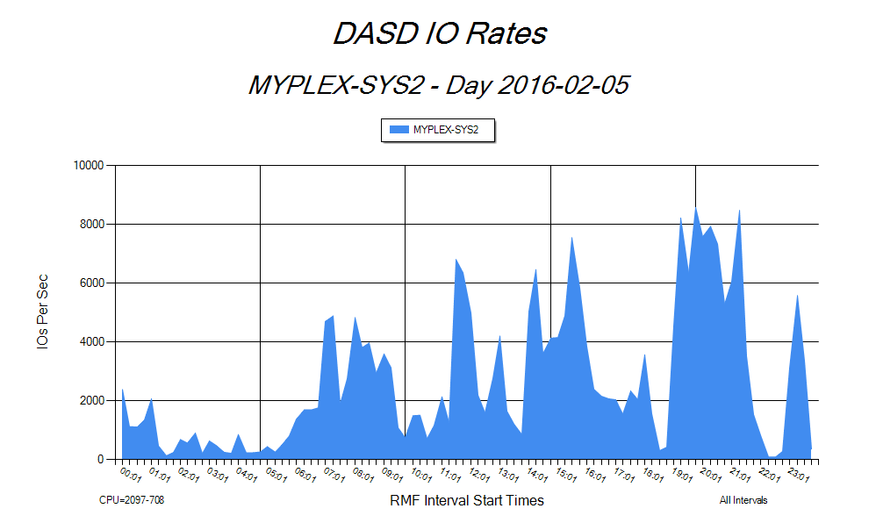
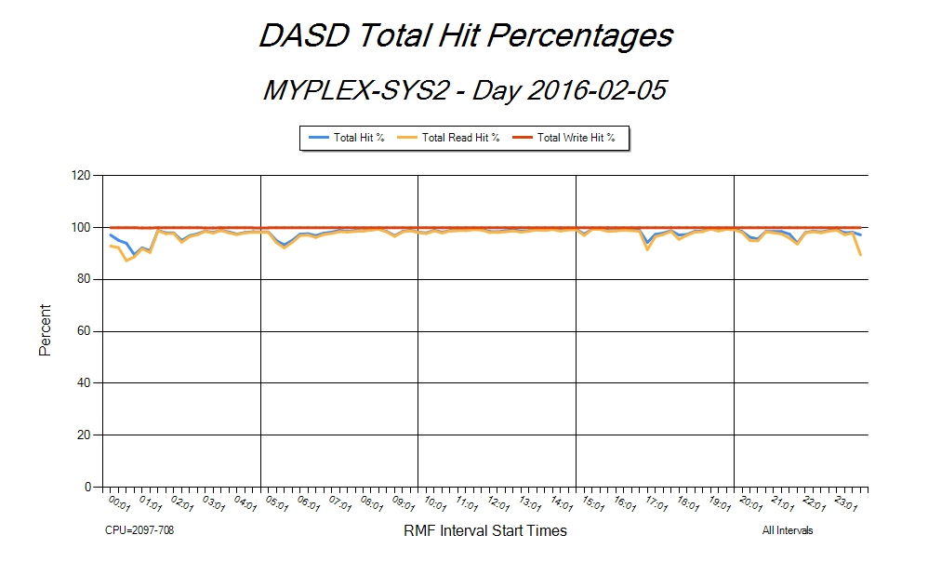
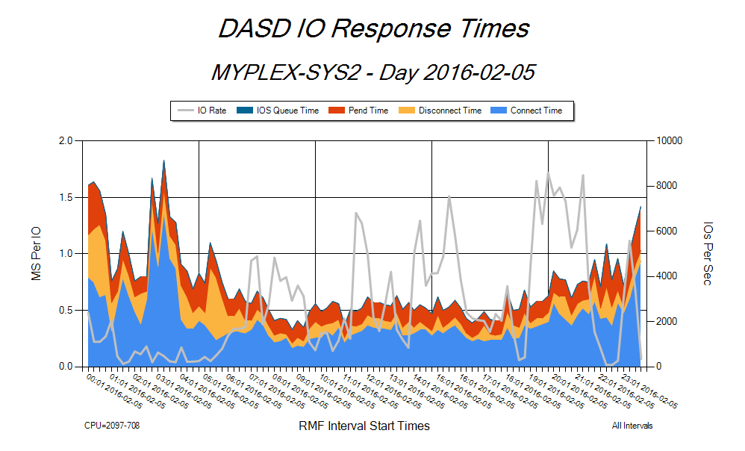
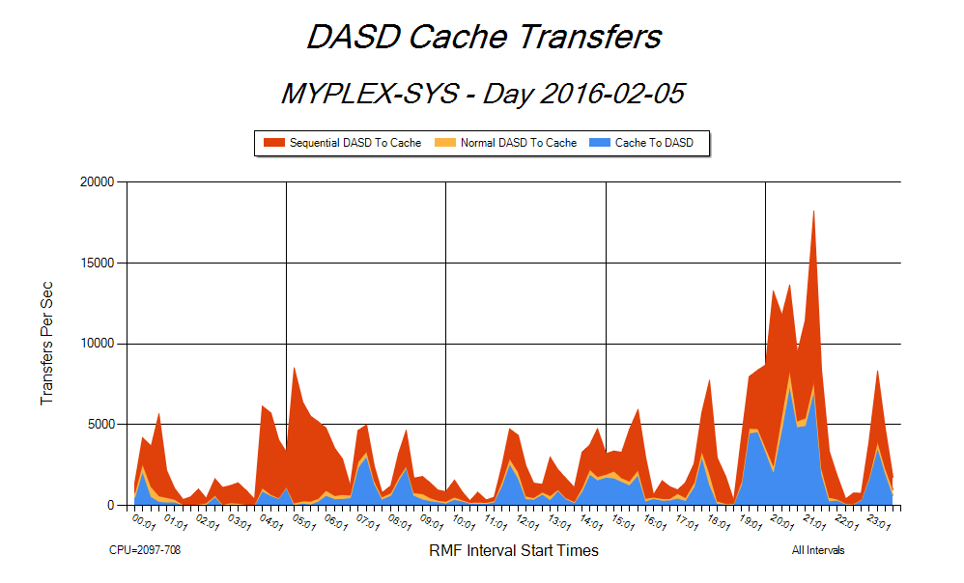
Complete view of DASD subsystem performance with IO rates, cache
hit %s, response times and cache transfers
DASD IO Subsystem Analysis
Notes:
Here we see four key charts the user might consult to assess the performance characteristics of the DASD IO subsystem. The charts show DASD IOs per second, hit percentages, response times (broken into four components) and actual transfers between Cache and DASD. These and additional charts are available at the LCU, Control Unit, Storage Group and Storage Subsystem level.

Slide 12
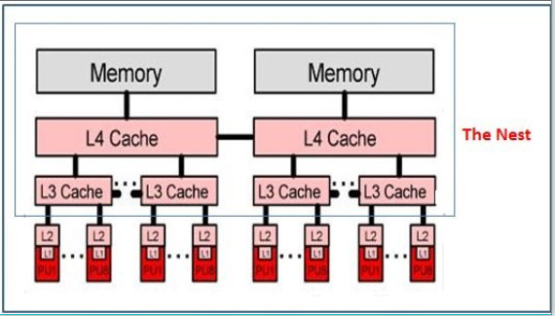
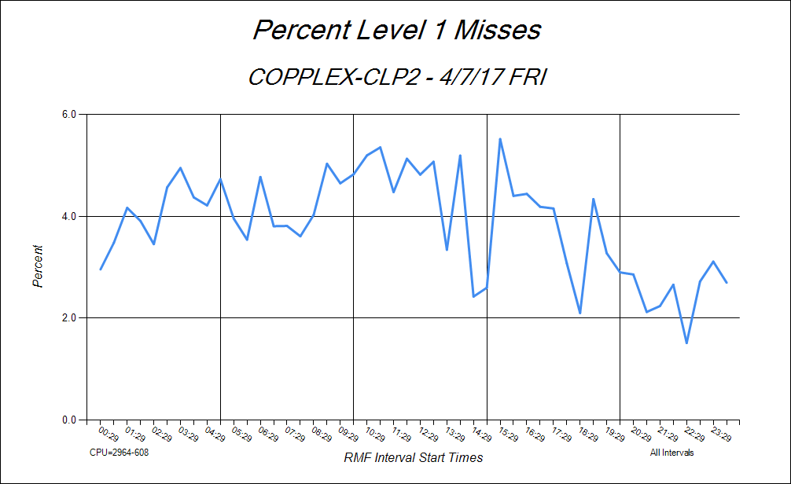
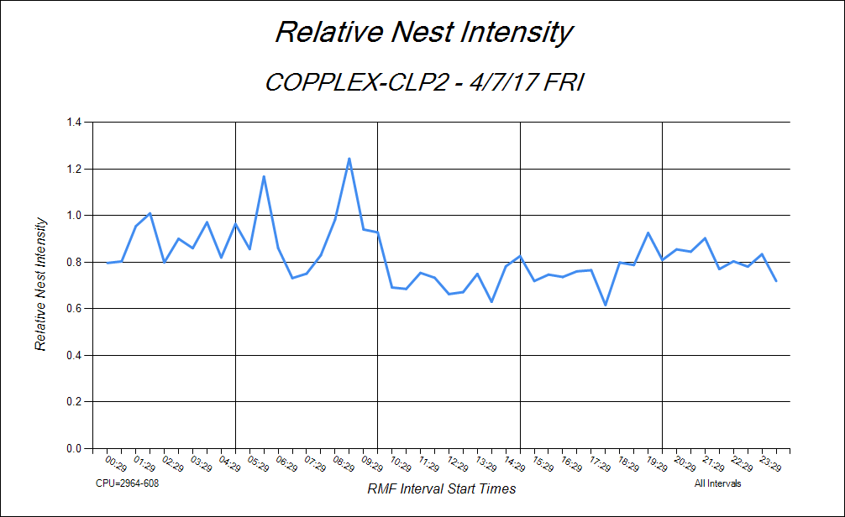
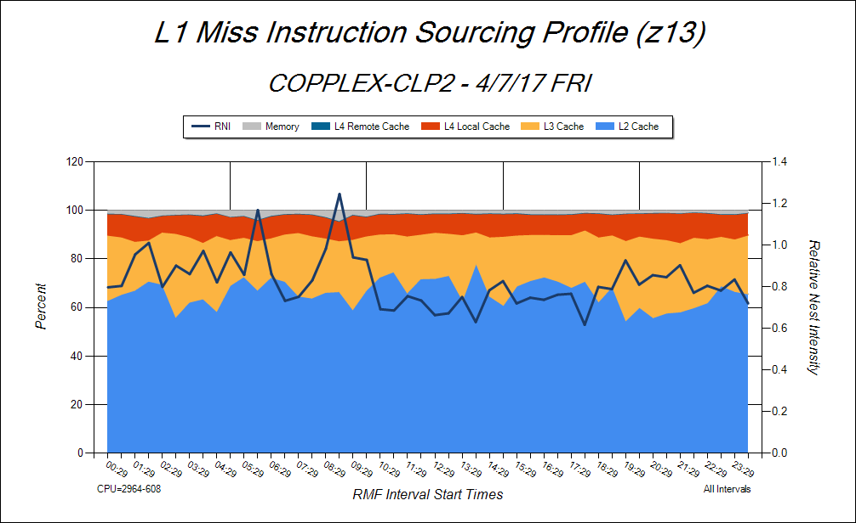
Processor Cache architecture for
Z13/z13s CPUs
% of instructions not sourced from Level 1 cache
(L1 misses)
Processor Cache Analysis
RNI is a dimensionless measure of the occupancy in ‘The Nest’. It should be
< 1
When RNI is high it is because in this case more L1 misses are sourced from memory
Notes:
An important performance issue is how effectively the work in a given LPAR is interfacing with the CPU’s processor cache architecture. PerfTechPro’s support of the SMF Type 113 records facilitates this analysis. The CPU shown is from the z10 family of IBM CPUs. The top left-hand picture shows a diagram of the processor cache in the z10 family of CPUs. The top right-hand chart shows the percentage of instructions not sourced from L1 cache. These are instructions that spend time in ‘the nest’ a term coined by IBM and shown in the cache architecture diagram. The bottom-left chart shows a metric called ‘Relative Nest Intensity’ (RNI), also coined by IBM, which measures the intensity of instructions presence in the nest. IBM says that RNI should be less than 1. The bottom right-hand chart shows a profile of the sourcing of L1 miss instructions. Instructions sourced from memory incur the most overhead.

Slide 13
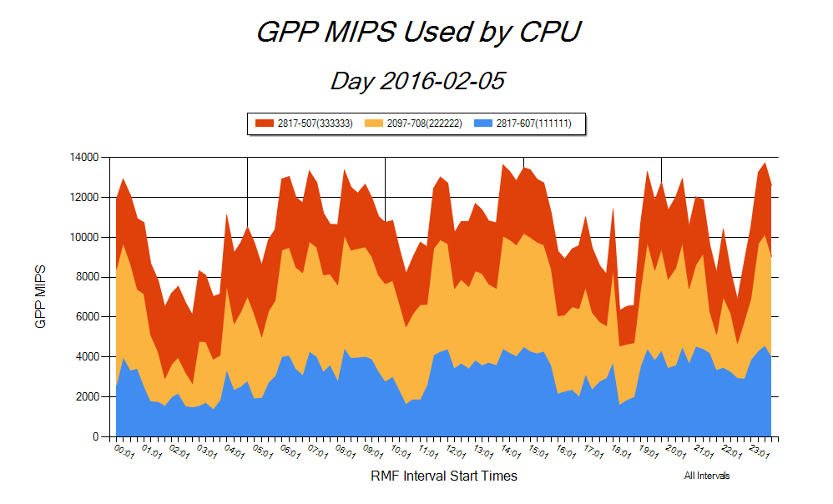
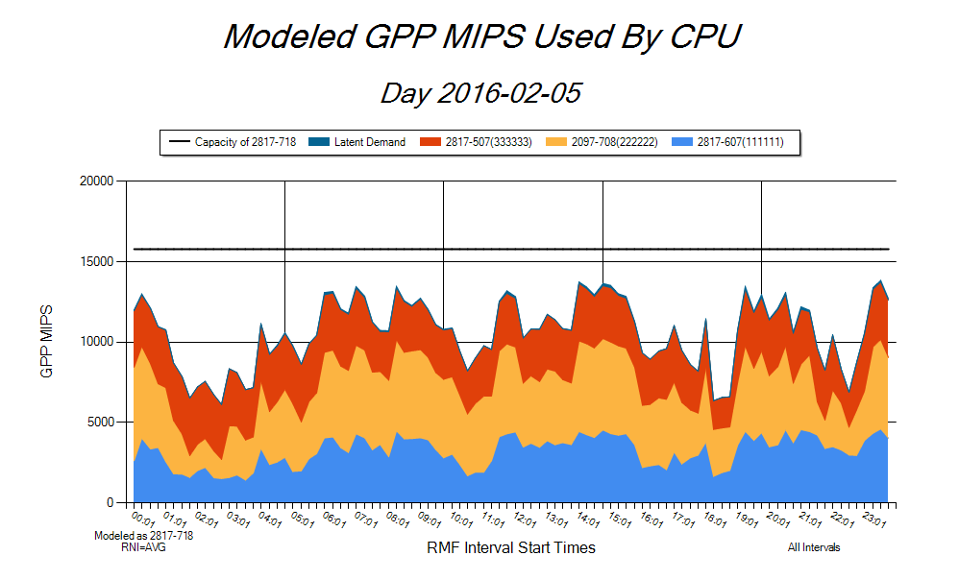
Capacity Planning - CPU Sizing
Question: What CPU could accommodate all of this work?
Answer:
A 2817-718 with AVG¹ RNI.
Note 1. IBM publishes 3 sets of RITRs for LOW, AVG and HIGH RNIs
Notes:
A typical capacity planning exercise is to size a CPU given a particular workload configuration. The PerfTechPro CPU Sizing tool is an ideal and easy-to-use solution for this problem. The top chart shows all of the MIPS used by the three CPUs in the enterprise on a particular day. The bottom chart, produced by the PerfTechPro CPU Sizing tool, shows these same MIPS as they would look on a 2817-718 assuming an average RNI. The bottom chart also estimates the size of any latent demand that exists in any of the three original CPUs and what it would look like on the 2817-718.

Slide 14
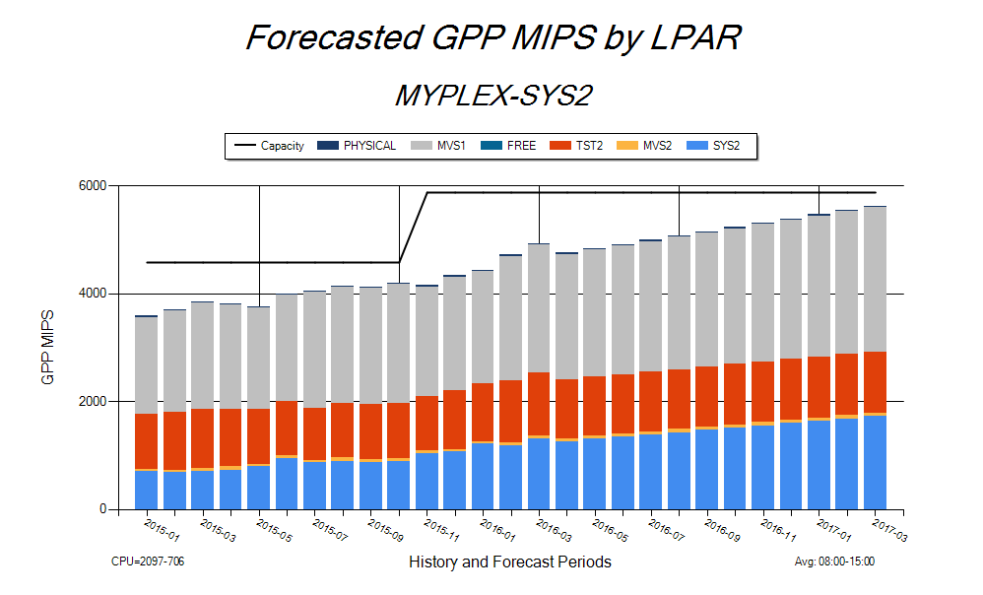
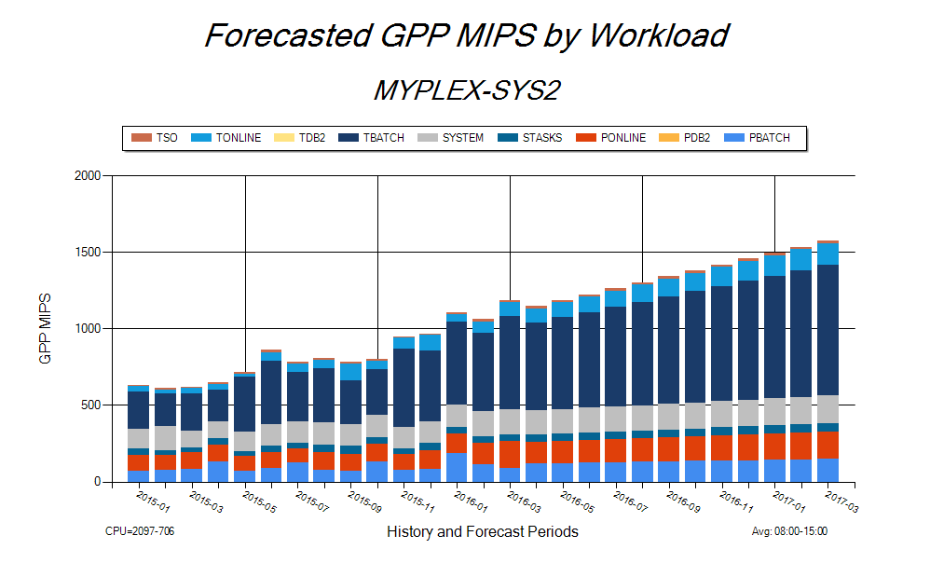
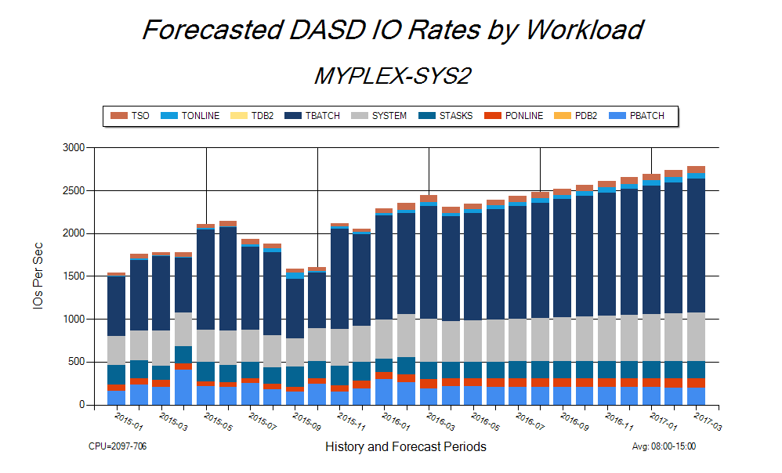
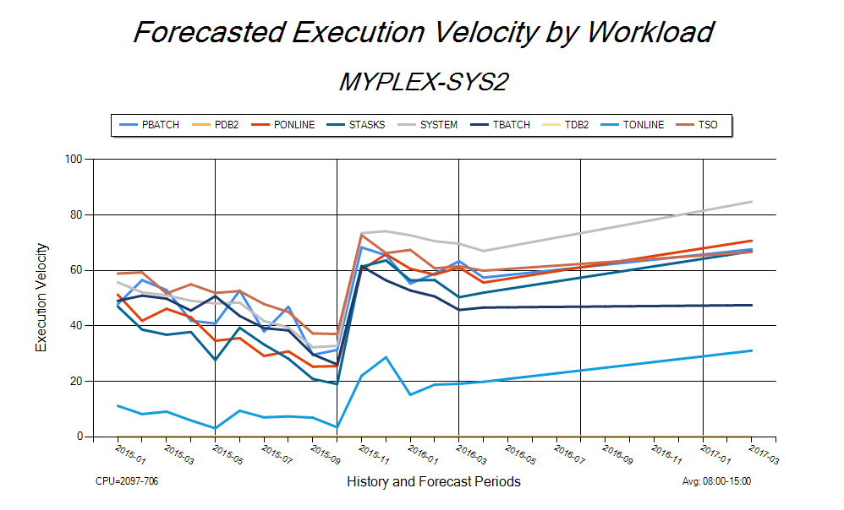
Capacity Planning – Forecasting Demand
Forecasted GPP MIPS by LPAR on
2097-706
Forecasted GPP MIPS by Workload on the SYS2 LPAR
Forecasted DASD IO demand
by Workload on SYS2 LPAR
Forecasted Execution Velocity by Workload in SYS2 LPAR.
Notes:
A threshold activity in building a capacity plan is forecasting demand. The PerfTechPro Forecasting tool is designed to facilitate this activity. This slide illustrates the type of output that is available from PerfTechPro’s Forecasting tool. The forecasts on each of the four charts are based on the previous 14 months of history data. There are forecasts for GPP MIPS at the LPAR level. There are forecasts for GPP MIPS, DASD IO Rates and Execution Velocity at the workload level in LPAR SYS2.

Slide 15
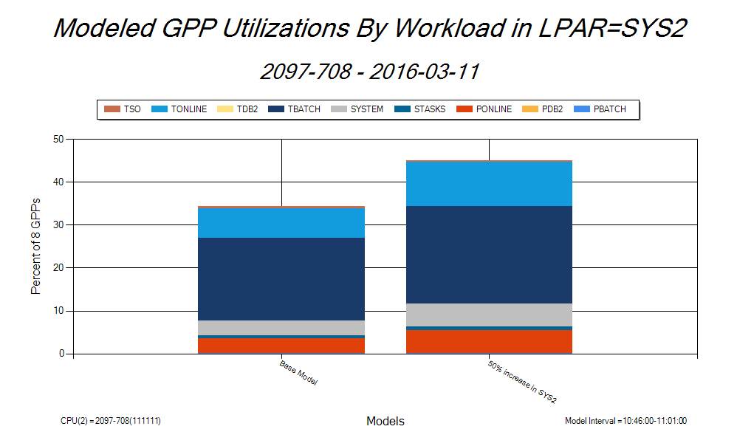
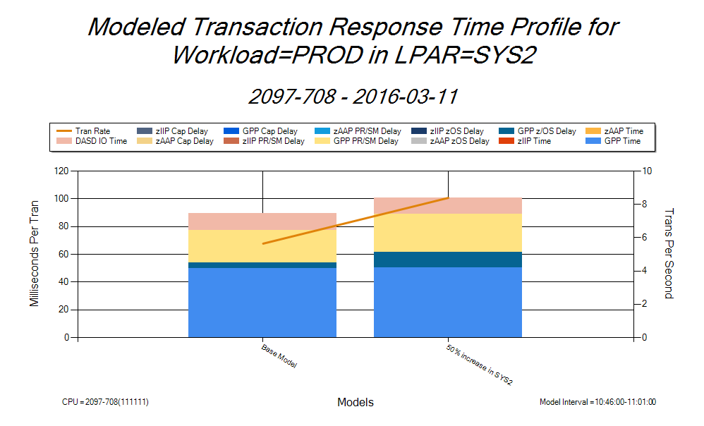
Capacity Planning - CPU Modeling
Question: What would happen if SYS2 work increased by 50% in 10AM to 11AM timeframe?
Model’s Answer: Tran response time for Workload PROD would increase due to CPU queueing.
Model’s Answer: CPU Utilization would increase.
Notes:
The PerfTechPro Modeling tool is designed to predict the performance characteristics of the work running in z/OS LPARs on an IBM mainframe. It is a simulation based modeling tool that can estimate future performance as a function of various changes to the system including: CPU changes, LPAR configuration changes and workload changes. This slide illustrates the use of the Modeling tool in PerfTechPro to answer a typical capacity planning query. The user wants an estimate of performance assuming the work in LPAR SYS2 were to increase by 50%. The chart on the left shows the model’s prediction of the increase in GPP utilization of the workloads in LPAR SYS2. The chart on the right shows the model’s prediction of the increase in transaction throughput and response time for the specific workload named PROD running in LPAR SYS2. The cause of the increase in transaction response time for workload PROD is the increase in GPP delay in the model. This may or may not be acceptable to the user.
Thank you for spending time with us to review some of the capabilities of PerfTechPro. If you have questions, please call or email us.

Slide 16
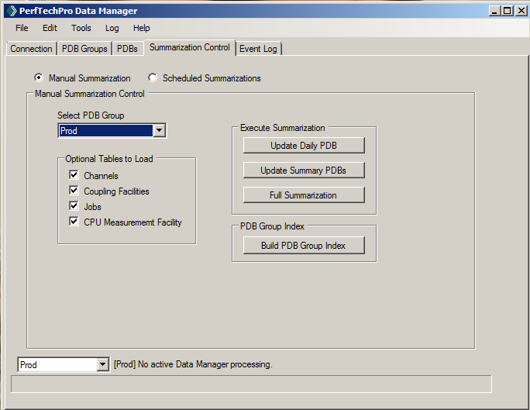
Data Manager

Slide 17
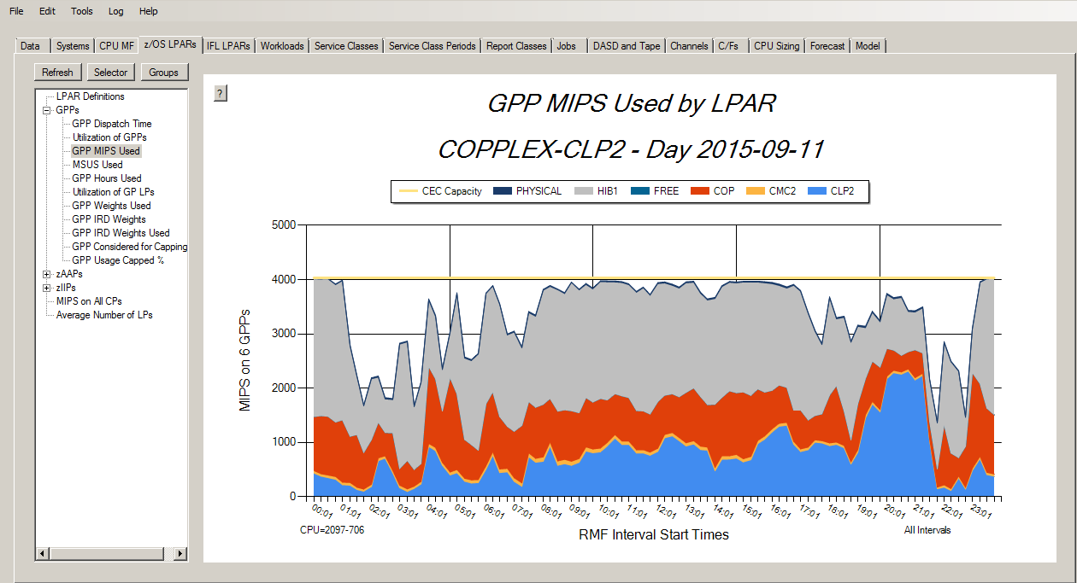
Visualizer

